Slide 1
A Window Into One Book
One Book
~
Many Perspectives
~
One Community
Civic Engagement, part of the Title V Grant initiative

Slide 2
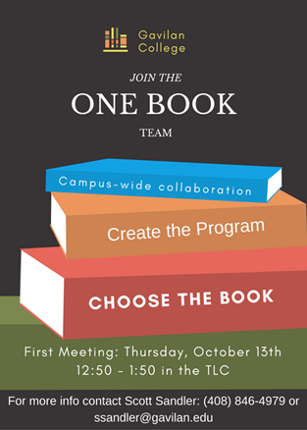
One Book Values Include:
Building community (on and off campus)
Creating opportunities for Social and Academic Engagement across the campus and across disciplines
Building bridges between literacy and engagement
Building partnerships through inquiry
Deepening the ways we experience a text by being inclusive and honoring multiple perspectives: “Reading the world always precedes reading the word, and reading the word implies continually reading the word” (Paulo Friere)
???

Slide 3

DREAMS
What might One Book look like on our campus?
Speaker Series
Poster Expos
Graffiti Walls
Photo contests around themes
Film Viewing and Discussion
Open Mic/Performance (poetry, prose, drama, etc.)
Debates/Inquiry question activities or events
Cross discipline partnerships
Campus-Community partnerships (Libraries, book stores, book clubs, etc.)

Slide 4

How can you help?
Resources
200 student books purchased with Equity money
Themes and sample curricula on Gavilan One Book web page
Attend Brown Bag – Thursday, Nov. 16th at 5:00 in the TLC
Let us know if you are interested next semester
Tell us ideas/ give us feedback
Potential activities/ guest speakers
Anything else?
Contact Sydney LaRose (slarose@gavilan.edu) or Scott Sandler (Ssandler@gavilan.edu) for more information

